Slide 1



Predicting Solar Power Output Using Linear Regression

Slide 2

Learning Objectives
Develop a Predictive Model: Create a linear regression model to estimate solar power output based on environmental and operational data.
Analyze Historical Data: Examine historical solar energy production data to identify trends and patterns.
Optimize Energy Planning: Provide actionable insights to optimize energy planning and management.
Train and Validate the Model: Train the linear regression model on real-world data and validate its performance.
Evaluate Model Accuracy: Assess the accuracy of the model using metrics like Mean Absolute Error (MAE), Mean Squared Error (MSE).
GOAL
Source :
www.freepik.com/

Slide 3
Tools and Technology used
1.Programming Language : Python
2.Libraries and Frameworks :
Python: numpy, pandas, matplotlib, seaborn, scikit-learn
3.Development Environment: Jupyter notebook or vs code
4.Data source: Historical solar power production of data

Slide 4
Methodology
1. Data Collection:
Historical Data
Operational Data
2. Data Preprocessing:
Data Cleaning
Normalization/Scaling
3.Exploratory Data Analysis (EDA):
Visualization
Correlation Analysis
4. Model Development:
Select Features
Split Data
Train Model
5. Model Evaluation:
Predict
Evaluate Performance
6. Model Optimization:
Parameter Tuning
Cross-Validation
7. Deployment:
Model Integration
Continuous Monitoring
8. Reporting and Visualization:
Generate Reports
Visualization

Slide 5
Problem Statement:
The increasing adoption of solar energy as a renewable source of power necessitates accurate and reliable methods for predicting solar power output. Accurate predictions can optimize energy management, enhance grid stability, and improve the efficiency of solar power systems.
Objective: Develop a linear regression model to predict solar power output based on historical weather data, operational data, and environmental factors.

Slide 6
Solution:
Step 1: Data Collection
Step 2: Data Preprocessing
Step 3: Exploratory Data Analysis (EDA)
Step 4: Model Development
Step 5: Model Evaluation
Step 6: Model Optimization
Step 7: Deployment
Step 8: Reporting and Visualization

Slide 7
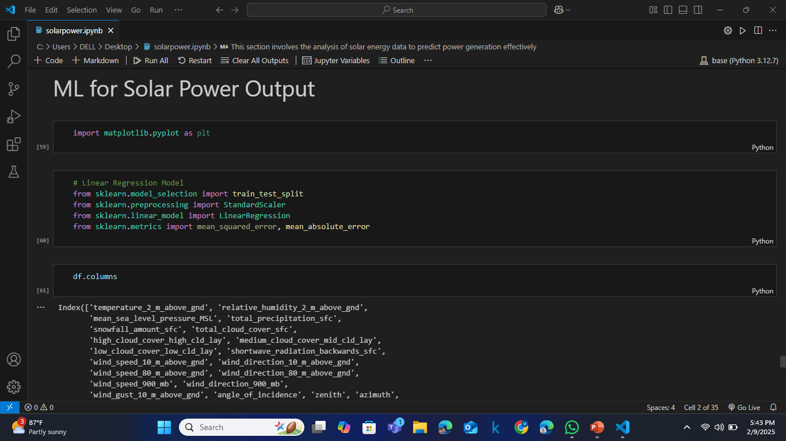
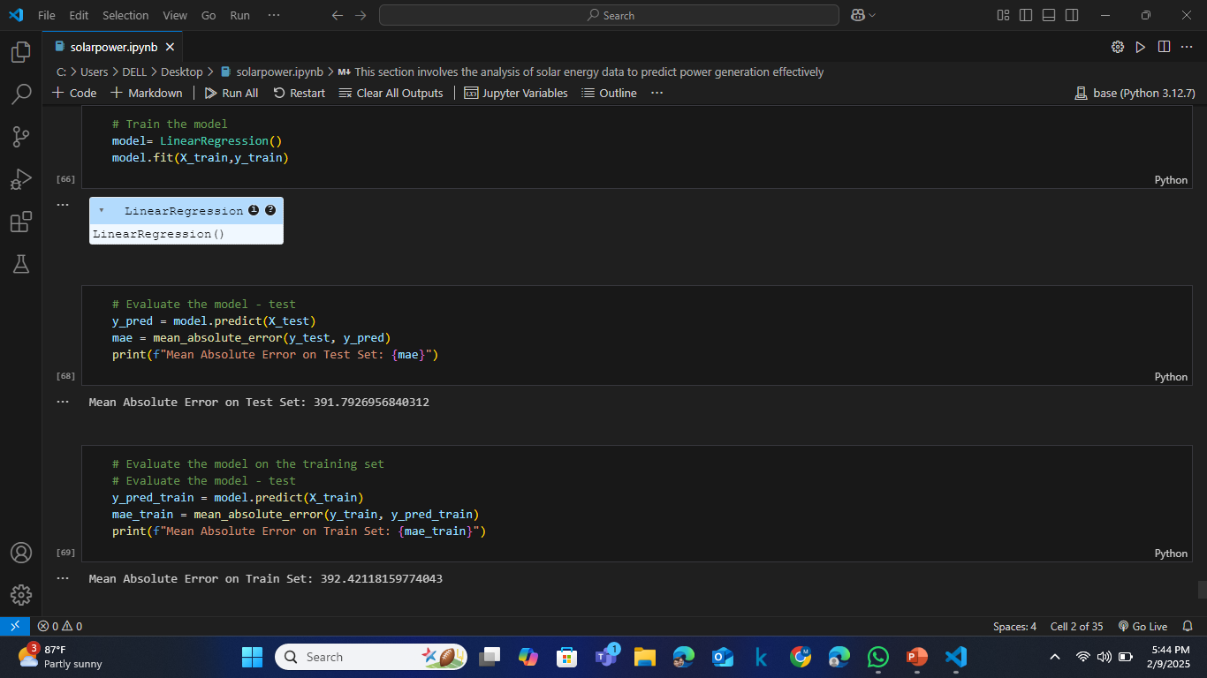
Screenshot of Output:

Slide 8
Conclusion:
The application of linear regression for predicting solar power output has demonstrated promising potential and viability. Through the analysis of key variables such as sunlight intensity, temperature, and historical power output data, the linear regression model was able to establish significant correlations that facilitate accurate predictions of solar power output.
The findings underscore the importance of precise data collection and the consideration of external factors affecting solar irradiance. While the linear regression model provides a straightforward and interpretable method, it also highlights the need for continuous model refinement and the potential incorporation of more sophisticated techniques to enhance prediction accuracy.
In summary, linear regression serves as a valuable tool for solar power forecasting, offering a foundation for further advancements in renewable energy analytics.

